Slide 1

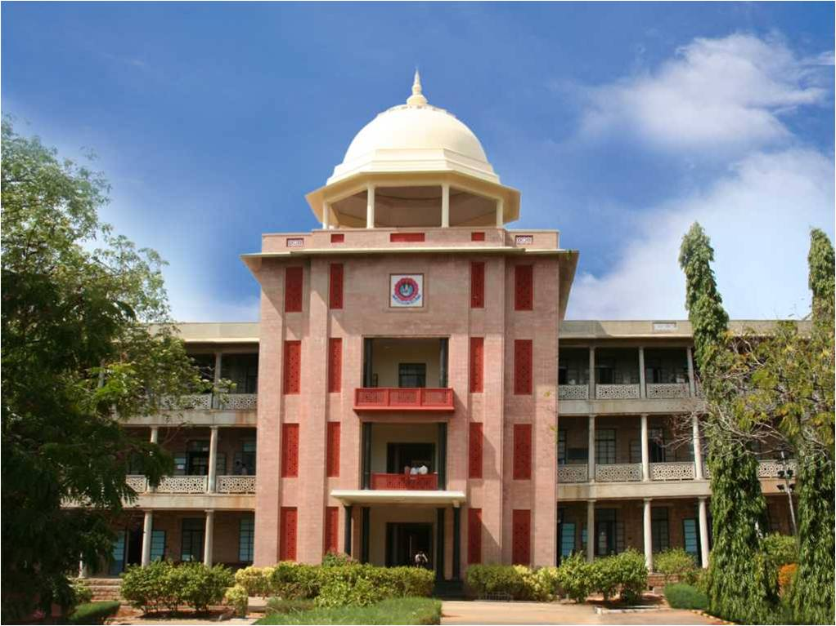
AI-Powered College Query Chatbot Using Agentic RAG, LLM, and LangChain
THIAGARAJAR COLLEGE OF ENGINEERING, MADURAI-15
(A Govt. Aided Autonomous Institution affiliated to Anna University)
- where quality and ethics matter
Submitted by,
Dinesh Prabhu S (21C026)
Hari Haran K (21C124)
Guided by,
Dr. M. Vijayalakshmi, M.E., Ph.D.,
Professor,
Department of CSE
*
<Department Name>
‹#›

Slide 2
Introduction
Chatbots, also known as conversational agents, are now a common part of the digital world.
The main purpose of chatbots is to provide information in a simple and efficient way.
Chatbots powered by modern AI and LLMs can provide fast, contextual, and accurate responses to natural language queries.
*
Department of Computer Science and Engineering
‹#›

Slide 3
Literature Review
S.No | Title of the Paper | Author(s) name | Journal Name | Contribution | Drawbacks
1 | Conversational Recommender System Chatbot Based on Functional Requirement | D. Theosaksomo and D. H. Widyantoro | 2019 IEEE 13th International Conference | Proposed a chatbot framework that recommends items based on functional requirements | Focused on recommendations; lacks document-based retrieval
2 | Towards Chatbot-based Interactive What- and How-Question Answering Systems: the Adobot Approach | L. T. Hien, L. Tran Thi Ly, C. Pham-Nguyen, T. Le Dinh, H. Tiet Gia, and L. N. Hoai Nam | 2020 RIVF International Conference | Designed Adobot for handling complex 'what' and 'how' questions interactively | Limited scope of questions and static knowledge base

Slide 4
Literature Review
S.No | Title of the Paper | Author(s) name | Journal Name | Contribution | Drawbacks
3 | Research on Users' Trust of Chatbots Driven by AI | F. Min, Z. Fang, Y. He, and J. Xuan | 2021 IEEE International Conference | Analyzed user trust in AI-driven chatbots | Focused on perception, not retrieval or accuracy
4 | Chatbot: A Question Answering System for Student | L. E. Chen, S. Y. Cheng, and J. -S. Heh | 2021 International Conference | Developed a chatbot for student query resolution | lacks advanced NLP integration
5 | A Chatbot for Academic Advising | R. Al-Jedaie, R. Al-Hindy, H. Al-Onazi, E. Kariri, and F. Masmoudi | 2022 International Conference | Created a chatbot to assist students with course selection and academic planning | Limited generalizability; not based on RAG or LLM models

Slide 5
Problem Statement
Colleges receive numerous repetitive queries about courses, admissions, facilities etc.
Manually addressing these queries is time-consuming
Traditional static web pages or human responses are time-consuming and prone to inconsistency.
Users struggle to find specific details, may lead to misinformation.
There is a need for an intelligent system that can retrieve relevant information accurately .

Slide 6
Objective
The primary objective of this project is to design and develop an intelligent, automated query resolution system for college-related information. The key goals are as follows:
Automate Query Handling: Create a system that can automatically answer common college-related queries, such as those related to courses, schedules, campus facilities, events, and faculty details, providing accurate and timely responses.
Enhance User Experience: Improve the user experience for students, faculty, and staff by offering a 24/7 accessible platform that provides quick and relevant answers to their queries in natural language.
Reduce Administrative Burden: Minimize the workload of administrative staff by reducing the volume of repetitive queries, allowing them to focus on more complex tasks.

Slide 7
Methodologies to meet the Objective
1. Data Collection and Preprocessing (Web Scraping)
2. Text Segmentation and Embedding Generation
3. Creation of Vector Store Database (Supabase)
4. Agentic RAG Model Construction (Langchain)
5. Integration of LLM (meta-llama-3.3-70B)
6. Web Interface Development (Streamlit)

Slide 8
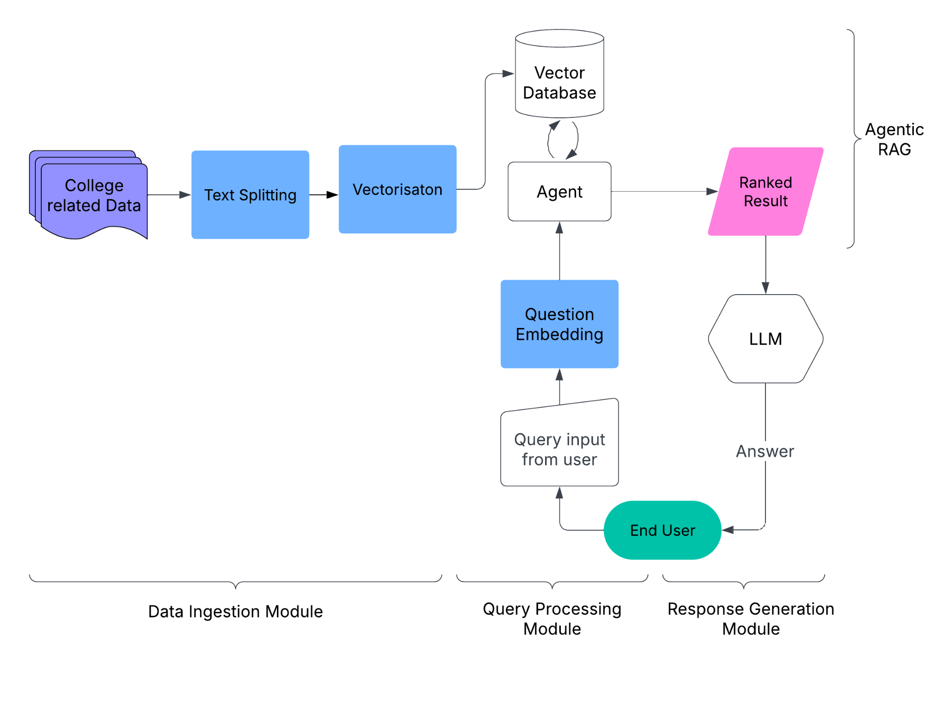
Design of the Proposed System

Slide 9
Contribution
Member 1 (Dinesh Prabhu S) :
Integrated Meta-Llama 3.3 with LangChain for generating answers.
Set up Agentic RAG logic to combine retrieval and reasoning.
Created vector store using Supabase and Nomic embeddings.
Wrote backend logic for tool calling and LLM interaction.
Member 2 (Hari Haran K) :
Designed the chatbot interface using Streamlit.
Developed the document upload and text-splitting process.
Handled chat history, formatting, and error handling in UI.
Tested chatbot with queries and validated the responses.

Slide 10
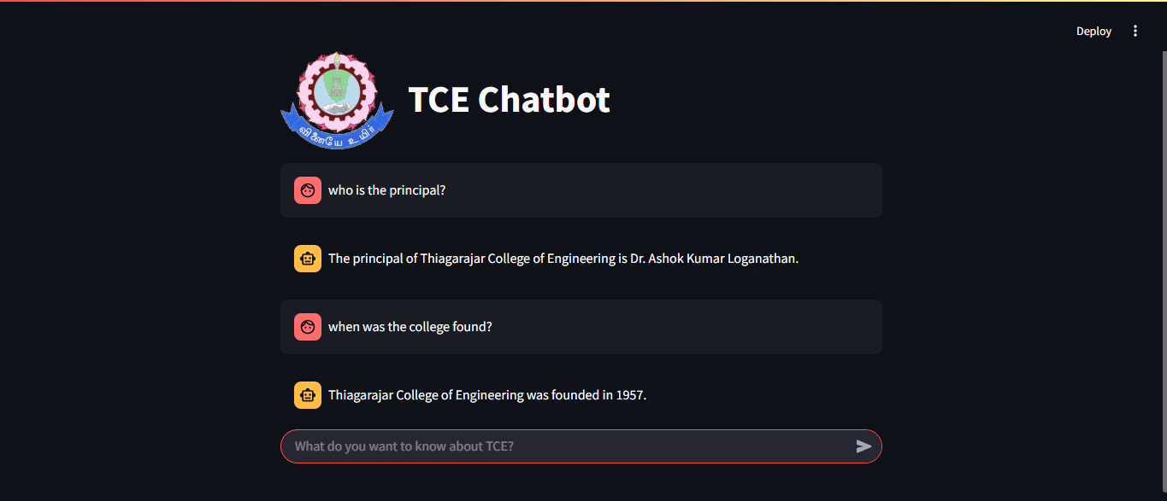
Results and Discussion

Slide 11
Conclusion
The chatbot efficiently answers queries using AI, enhancing the accessibility of institutional information.
Agentic RAG combined with Meta-Llama 3.3 ensures fact-based, complete responses drawn directly from college documents.
Supabase serves as a reliable vector store, while Nomic embeddings enable accurate semantic matching for document retrieval.
The Streamlit-based interface provides a seamless and interactive experience for users, making the chatbot accessible and easy to use.
Overall, the system significantly reduces the manual query handling and improves the accuracy, speed, and consistency of information delivery.

Slide 12
Future Scope
Real-Time Updates: Enable dynamic syncing with newly uploaded college documents and circulars.
Advanced Reasoning: Integrate reasoning capabilities to answer complex, multi-step queries.
Authentication Layer: Personalize responses based on user type (e.g., applicant, current student, staff).
Analytics Dashboard: Track most-asked queries to help the institution understand user needs better.
Live Document Syncing: Automatically update the vector store when college documents are modified.

Slide 13
References
DataCamp Blog. (2025). Agentic RAG: How It Works, Use Cases, Comparison With RAG. https://www.datacamp.com/blog/agentic-rag
LinkedIn Pulse. (2024). Top LLMs for Chatbots: Generative AI Guide. https://www.linkedin.com/pulse/top-llms-chatbots-generative-ai-guide-covisian-s50uf
Skillcrush Blog. (2025). The Top 5 LLM Frameworks in 2025. https://skillcrush.com/blog/best-llm-frameworks/
TiDB Blog. (2024). Step-by-Step Guide to Using LangChain for AI Projects. https://www.pingcap.com/article/step-by-step-guide-to-using-langchain-for-ai-projects/
Supabase Documentation. (n.d.). Supabase Documentation. https://supabase.io/docs
Streamlit Documentation. (n.d.). Streamlit Documentation. https://streamlit.io/docs
PyCharm Blog. (2024). How to Build Chatbots With LangChain. https://blog.jetbrains.com/pycharm/2024/08/how-to-build-chatbots-with-langchain/
Skillcrush Blog. (2025). The Top 5 LLM Frameworks in 2025. https://skillcrush.com/blog/best-llm-frameworks/

Slide 14
Publications
Authors: Dinesh Prabhu S, Hari Haran K, Dr. M. Vijayalakshmi
Title: AI-Powered College Query Chatbot Using Agentic RAG, LLM, and LangChain
Status of the Publication: Submitted
Conference Details: 2025 International Conference on Computing, Intelligence, and Application (CIACON).
July 18-19,2025

Slide 15
THANK YOU

